Slide 1
RGB COLOR SENSING ROBOT
BY:
RUTH BALAJI (39130382)
SUBHARAJA CHELLAM.A (39130443)
DEVADHARSHINI (39130108)
SNEHA.S (39130434)
Guided by: Dr. ANBARASI JEBASELVI, M.E., Ph.D.

Slide 2
OVERVIEW
ABSTRACT
INTRODUCTION ON RGB
BLOCK DIAGRAM
COMPONENTS
DESCRIPTION OF EACH COMPONENT
WORKING
CONCLUSION
REFERENCES

Slide 3
ABSTRACT
Thus Arduino RGB Color Detector using TCS3200 Color Sensor is a wonderful project for students who want to have fun with too many colors. In this project, we will be “Interfacing TCS3200 Color Sensor with Arduino” for designing a simple color detector.
Earlier we learned about APDS9960 Color Sensor.
Experimental Set-Up has been designed specifically for detecting the frequency of RGB color.
The LCD panel directly displays the frequency of RGB color. A combination of all these colors gives a different color.
There is various software available which directly converts the combination of RGB frequency into the desired color. The set up is absolutely self-contained and requires no other apparatus.
We make it Robot setup based on RGB color sensing robot.

Slide 4
INTRODUCTION TO RGB
TCS3200 RGB Color Sensor For Arduino is a complete color detector, including a TAOS TCS3200 RGB sensor chip and 4 white LEDs.
The TCS3200 can detect and measure a nearly limitless range of visible colors. Applications include test strip reading, sorting by color, ambient light sensing and calibration, and color matching.
The TCS3200 RGB Color Sensor For Arduino has an array of photodetectors, each with either a red, green, or blue filter, or no filter (clear).
The filters of each color are distributed evenly throughout the array to eliminate location bias among the colors.
Internal to the device is an oscillator that produces a square-wave output whose frequency is proportional to the intensity of the chosen color.
The TCS3200 color sensor can detect a wide variety of colors based on their wavelength.
This sensor is especially useful for color recognition projects such as color matching, color sorting, test strip reading, and much more.

Slide 5
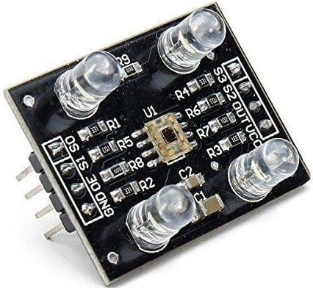

Slide 6
BLOCK DIAGRAM
BATTERY
RGB
(TCS3200)
ARDUINO UNO
DRIVER(L293D)
ROBOT SETUP
LCD

Slide 7
COMPONENTS
HARDWARE:
Arduino UNO
Lcd
Battery
L293d
Robot chases
Motor
SOFTWARE:
Arduino IDE

Slide 8
Arduino UNO
Arduino UNO is a low-cost, flexible, and easy-to-use programmable open-source microcontroller board that can be integrated into a variety of electronic projects.
This board can be interfaced with other Arduino boards, Arduino shields, and Raspberry Pi boards and can control relays, LEDs, servos, and motors as an output.
Arduino is an open-source electronics platform based on easy-to-use hardware and software.
Arduino boards are able to read inputs – light on a sensor, a finger on a button, or a Twitter message – and turn it into an output – activating a motor, turning on an LED, or publishing something online.
Arduino Uno is a microcontroller board based on the ATmega328P.
It has 14 digital input/output pins (of which 6 can be used as PWM outputs), 6 analog inputs, a 16 MHz ceramic resonator (CSTCE16M0V53-R0), a USB connection, a power jack, an ICSP header and a reset button.
It contains everything needed to support the microcontroller; simply connect it to a computer with a USB cable or power it with an AC-to-DC adapter or battery to get started.

Slide 9
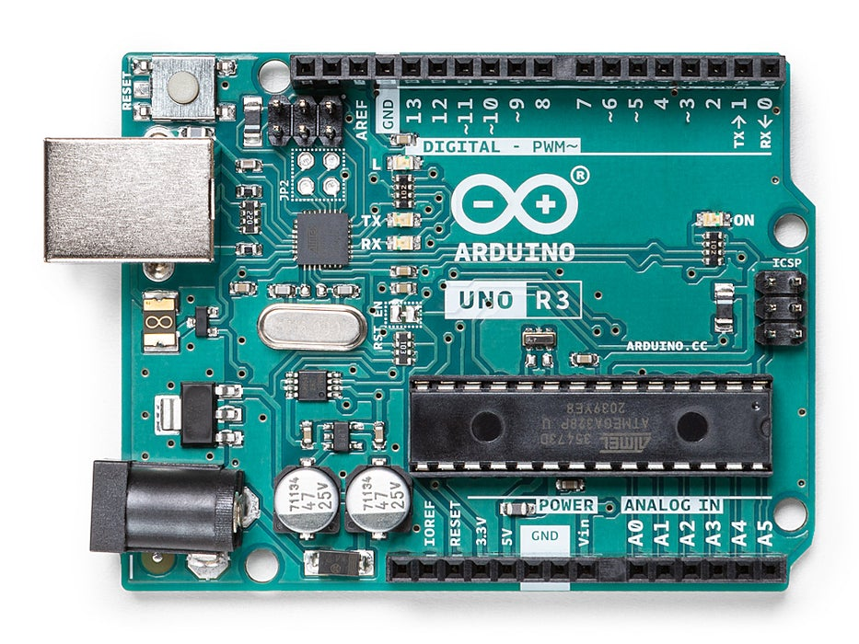

Slide 10
LIQUID CRYSTAL DISPLAY
A liquid-crystal display (LCD) is a flat-panel display or another electronically modulated optical device that uses the light-modulating properties of liquid crystals combined with polarizers. Liquid crystals do not emit light directly, instead using a backlight or reflector to produce images in color or monochrome.
It has materials that combine the properties of both liquids and crystals. Rather than having a melting point, they have a temperature range within which the molecules are almost as mobile as they would be in a liquid, but are grouped together in an ordered form similar to a crystal.
An LCD consists of two glass panels, with the liquid crystal material sand witched in between them. The inner surface of the glass plates are coated with transparent electrodes which define the character, symbols or patterns to be displayed polymeric layers are present in between the electrodes and the liquid crystal, which makes the liquid crystal molecules to maintain a defined orientation angle.

Slide 11
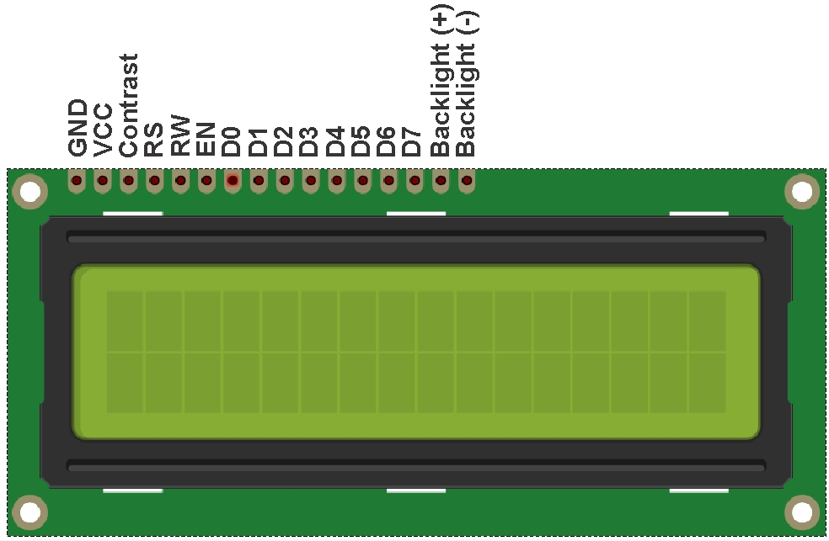

Slide 12
BATTERY
A battery can be defined as an electrochemical device (consisting of one or more electrochemical cells) that can be charged with an electric current and discharged whenever required.
Batteries are usually devices that are made up of multiple electrochemical cells that are connected to external inputs and outputs.
Batteries are widely employed in order to power small electric devices such as mobile phones, remotes, and flashlights.
Historically, the ‘term’ battery has always been used in order to refer to the combination of two or more electrochemical cells. However, the modern definition of the term ‘battery’ is believed to accommodate devices that only feature a single cell.

Slide 13
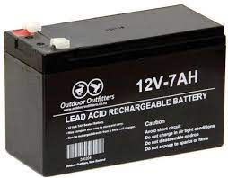

Slide 14
L293d
L293D is a typical Motor driver or Motor Driver IC which allows DC motor to drive on either direction. L293D is a 16-pin IC that can control a set of two DC motors simultaneously in any direction. It means that you can control two DC motors with a single L293D IC. Dual H-bridge Motor Driver integrated circuit (IC). The l293d can drive small and quite big motors as well, check the Voltage Specification at the end of this page for more info.
It works on the concept of H-bridge. H-bridge is a circuit that allows the voltage to be flown in either direction. As you know voltage needs to change its direction for being able to rotate the motor in the clockwise or anticlockwise direction, Hence H-bridge IC are ideal for driving a DC motor. In a single L293D chip there are two h-Bridge circuits inside the IC which can rotate two dc motors independently. Due to its size it is very much used in the robotic application for controlling DC motors. Given below is the pin diagram of an L293D motor controller. There are two Enable pins on l293d. Pin 1 and pin 9, for being able to drive the motor, the pin 1 and 9 need to be high. For driving the motor with the left H-bridge you need to enable pin 1 to be high. And for the right H-Bridge, you need to make pin 9 to high. If anyone of either pin1 or pin9 goes low then the motor in the corresponding section will suspend working. It’s like a switch.

Slide 15
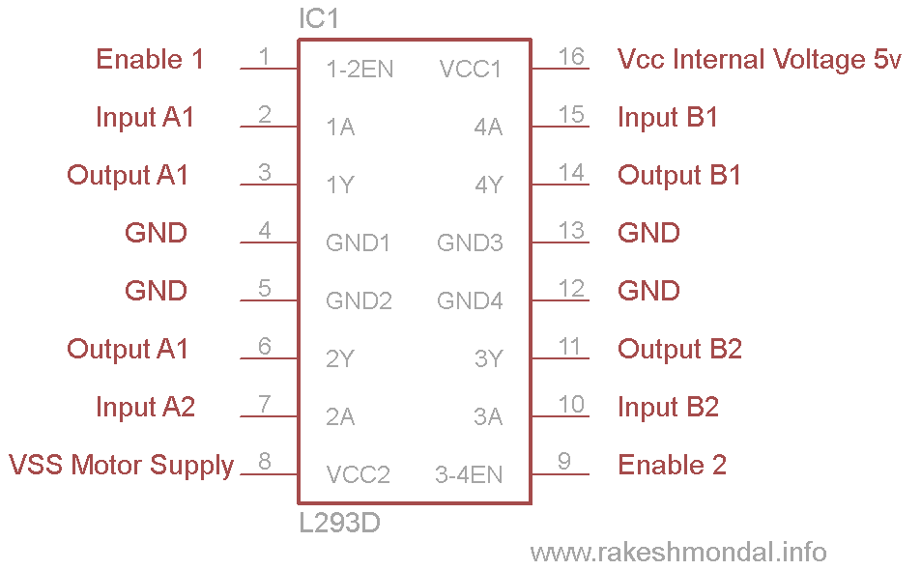

Slide 16
ROBOT CHASSIS
The chassis is the structural component of the robot which contains the drivetrain and allows the robot to be mobile by using wheels, tank treads, or another method. A chassis is sometimes referred to as the robot's frame.
The chassis also provides a structure to attach manipulators such as arms, claws, lifts, plows, conveyor systems, object intakes, and other design features used to manipulate objects.

Slide 17
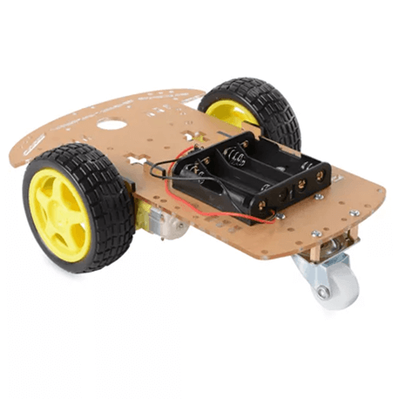

Slide 18
MOTOR
An electric motor is an electrical machine that converts electrical energy into mechanical energy. Most electric motors operate through the interaction between the motor's magnetic field and electric current in a wire winding to generate force in the form of torque applied on the motor's shaft. An electric generator is mechanically identical to an electric motor, but operates with a reversed flow of power, converting mechanical energy into electrical energy.
Electric motors can be powered by direct current (DC) sources, such as from batteries, or rectifiers, or by alternating current (AC) sources, such as a power grid, inverters, or electrical generators.
A DC motor is defined as a class of electrical motors that convert direct current electrical energy into mechanical energy.

Slide 19
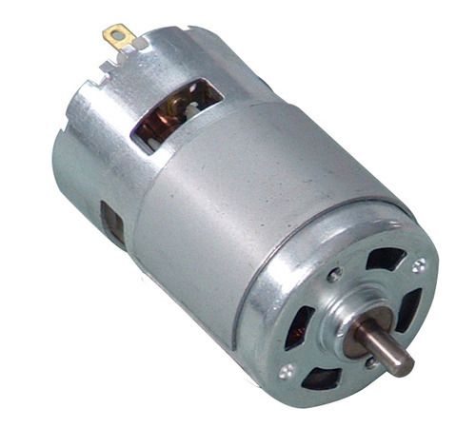

Slide 20
ARDUINO IDE
The Arduino IDE is an open-source software, which is used to write and upload code to the Arduino boards. The IDE application is suitable for different operating systems such as Windows, Mac OS X, and Linux. It supports the programming languages C and C++. Here, IDE stands for Integrated Development Environment.
The program or code written in the Arduino IDE is often called as sketching. We need to connect the Genuino and Arduino board with the IDE to upload the sketch written in the Arduino IDE software. The sketch is saved with the extension '.ino.'

Slide 21
WORKING
In this project the Dc motor is connected to the front two wheels and the dc motor uses 100 RPM and the voltage supplied to the motor is 12V. A power supply board is used in order to supply the correct amount of voltage to other materials. In the power supply board 12volt, ground, and 5volt are connected. The 12-volt, ground, and 5volt are connected to the motor driver. The input pins in the motor driver are connected to the microcontroller pins 5,6 and 7. The color sensor is used to detect the RGB color and it is connected to the microcontroller. When the robot is on, the LCD displays “RGB robot”, after which when an object is placed in front of the color sensor, for example, Red color is brought in contact with the color sensor then it gets identified and the frequency of the red color object is determined and displayed on the LCD, depending on the frequency the color gets recognized and displayed as the output stating the color “RED” and it’s the same way for green and blue color. Each and every object for the RGB colors have a different frequency, on determining the frequency the program is run and the color is shown in the output stating the color.

Slide 22
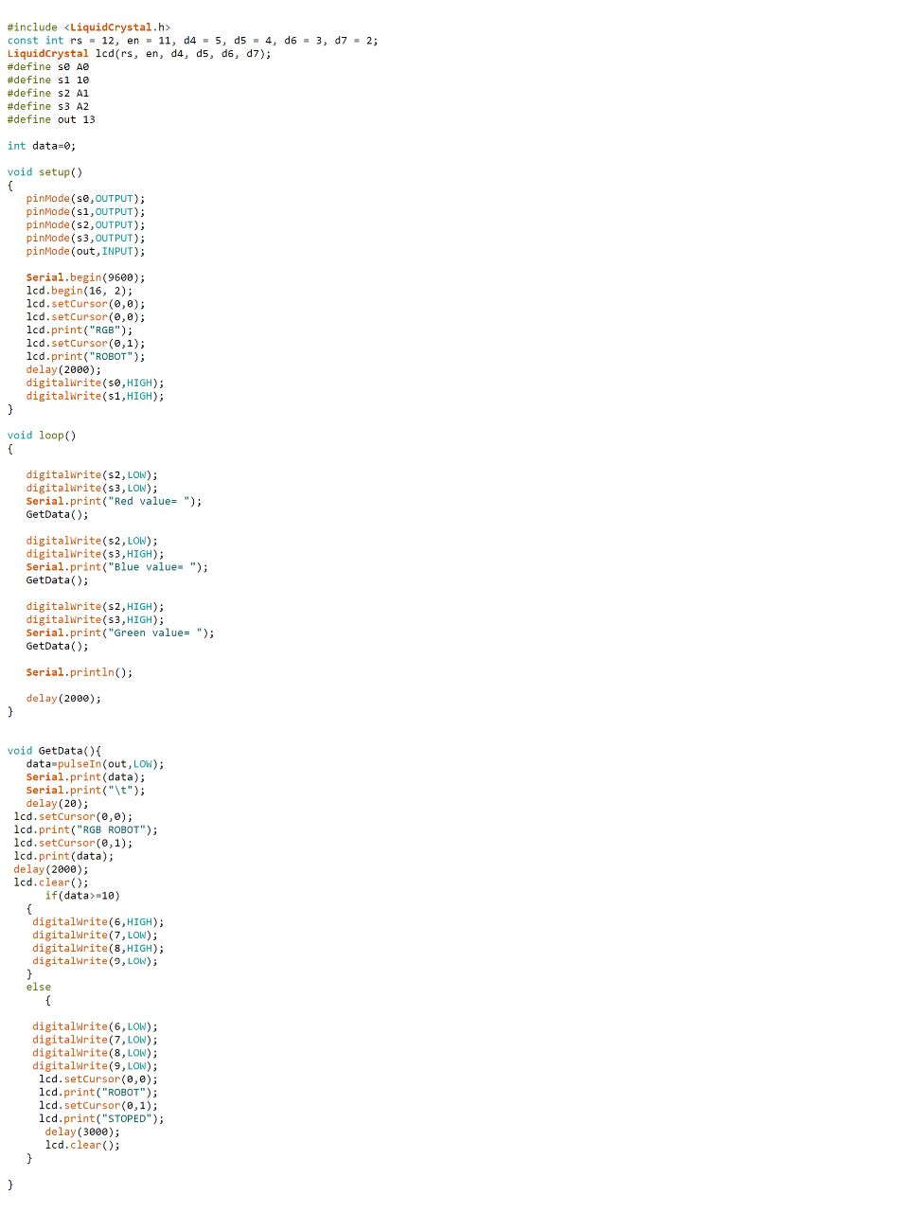

Slide 23
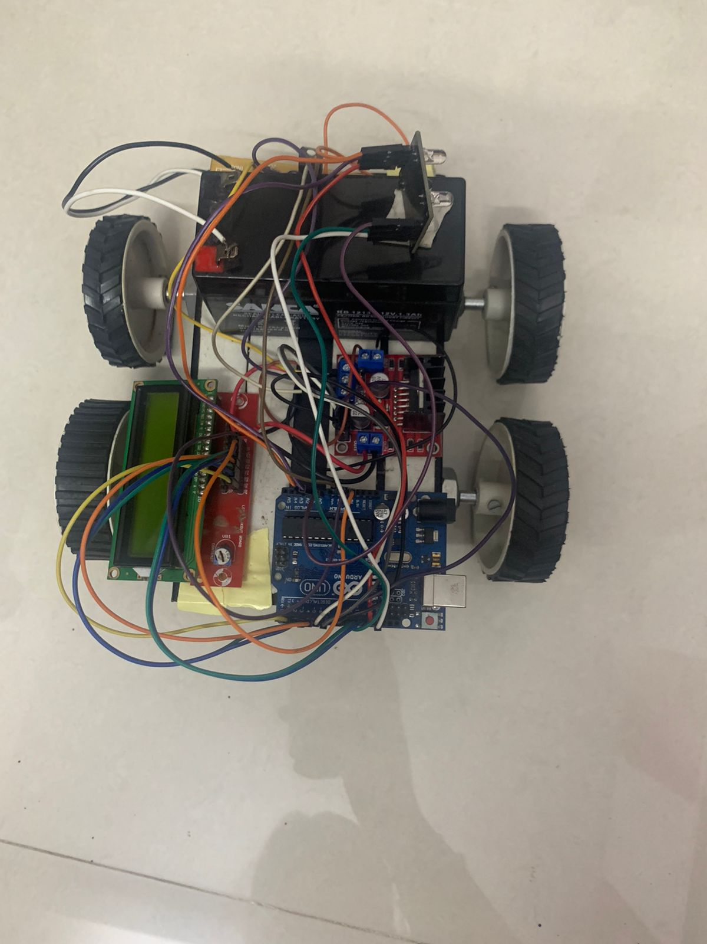

Slide 24
CONCLUSION
In this project we are able to make the robot identify the RGB colors that are red, green, and blue, and the frequency of the colors are displayed on the LCD in the form of numbers so that we get the output in the program stating the color.
This project is very much useful for children to study the colors as well as identify them.
The set up is absolutely self-contained.
It is a easy to use project.

Slide 25
REFERENCE
Ferat Sahin, “A Radial Basis Function Approach to a Color Image Classification Problem in a Real-Time Industrial Application”, 27 June 1997, Blacksburg, Virginia, page 1-16, 26 Feb 2006.
http://www.glassescrafter.com/information/how-eye-sees-color.html
http://en.wikipedia.org/wiki/RGB_color_model#cite_ref-RWGHunt_2-1
Naotoshi Sugano, Shou Komatsuzaki, et al., “Fuzzy Set Theoretical Analysis of Human Membership Values on the Color Triangle”.
M. Negnevitsky, “Artificial Intelligence,” in A Guide to Intelligent Systems, Second Edition, Pearson Education, Edinburgh: Addison Wesley, 2005. pp. 11

Slide 26
THANK YOU

